Slide 1









Advisor to UHNWIs, CEOs & Global Leaders | | Author | Global Speaker | Life Strategist & Business Coach | The “DIOR” of Transformation

Slide 2


Why 90% of High Achievers Never Reach Their True Potential
The hidden psychological, strategic, and behavioural barriers that prevent extraordinary success, fulfilment, wealth, and impact.
Not Intelligence. Not Ambition. Not Opportunity.
It Is Almost Always an Architecture Issue
"The Identity That Helped You Survive…"
…may be the identity stopping you from rising.
© 2026 Tony J. Selimi. All Rights Reserved.

Slide 3
The Questions That Reveal the Real Challenge
If two or more of these create friction — it is an architecture issue, not an effort issue.
1
Values or Ambition?
2
Identity Expansion
Is your current growth aligned with your deepest values — or just your ambition?
Has your identity expanded to match your current level of responsibility?
3
Sustainability or Survival?
4
The Five-Year Question
Is your schedule designed for sustainable performance — or are you running on fear & fumes?
If you maintain your current pace for five more years — what does it cost you, your family, and your business?
© 2026 Tony J. Selimi. All Rights Reserved.

Slide 4

The Real Problem — Recognised but Rarely Named
Business Owners & Entrepreneurs
CEOs & Leaders
Plateaued growth, inconsistent revenue, attracting investors, filling events, decision fatigue, overcoming burnout, or breaking free from fear, self-doubt, anxiety, addictions, unworthiness, and destructive habits.
Success without fulfilment, constant pressure, diminishing fulfillment, direction, a loss of purpose, and an identity that no longer serves their next level of growth— teams that sense the misalignment before you name it.
High Achievers
Couples & Families
Winning externally. Losing internally. Respected publicly. Misunderstood privately.
Communication breakdown, emotional disconnection, conflict, and relational drift that compounds over years.
© 2026 Tony J. Selimi. All Rights Reserved.

Slide 5


The Hidden Cost of Staying Where You Are
Inaction is not neutral. Every month without recalibration compounds the cost.
Revenue & Business
Leadership
Growth plateaus, ecosystems that cannot scale, opportunities permanently missed.
Influence shrinks when identity is fractured — customers & teams sense it before you articulate it.
Health
Legacy
Chronic stress, burnout, prone to addictions, gambling, anxiety, ADHD, and physical depletion from operating in survival mode indefinitely.
Years pass without a structure that outlives your effort or your presence in the room.
The compound cost of delay is far greater than any investment in change.
Marriage & Family
Emotional absence — leading to divorce & your children inherit your patterns, not just your wealth.
© 2026 Tony J. Selimi. All Rights Reserved.

Slide 6

Why Smart People Stay Stuck: The 6 Invisible Barriers
01
Limiting Beliefs
Inherited narratives that quietly cap ambition and self-worth.
02
Emotional Blind Spots
Unprocessed patterns driving decisions below the level of conscious awareness.
03
Poor Decision Architecture
Optimising tactics before auditing the identity behind them.
04
Unresolved Conflict
Internal or relational friction that silently drains strategic energy.
05
Lack of Clarity & Misaligned Priorities
Busy without direction. Building the wrong things for the wrong reasons.
06
Ineffective Execution
Vision without a system that reliably translates intention into results.
© 2026 Tony J. Selimi. All Rights Reserved.

Slide 7

Tony J. Selimi: Everything I Teach Has Been Tested in Real Life
Born Into Adversity
79,000+ Hours of Enterprise Environments & Elite Advisory
Homelessness, civil war, reinvention — not privilege or certainty. Shaped by a deep desire to understand what makes human beings collapse or rise under pressure.
15 years leading digital transformation up to £10B. Advising and coaching CEOs at the highest level, politicians, lawyers, financiers, medical directors, UHNWIs, and global members of Royal families.
Award-Winning Author & Creator
Several bestselling books including Climb Greater Heights. Creator of The Unfakeable Code®, The Octagon of Excellence®, ALARM®, The Identity Evolution Matrix®, The Human Evolution Framework, etc. Featured in Inspired (2027).
© 2026 Tony J. Selimi. All Rights Reserved.

Slide 8

The Three Levels of Identity Transformation™
Which level are you operating from?
Level 1 — Reactive Identity (The Survivor)
Driven by fear, survival, disintegrated ego, and emotional reactivity.
Level 2 — Intentional Identity (The Creator)
Takes full responsibility for choices, values, and direction.
Level 3 — Evolutionary Identity (The Legacy Architect)
Lives for contribution and stewardship.
© 2026 Tony J. Selimi. All Rights Reserved.

Slide 9
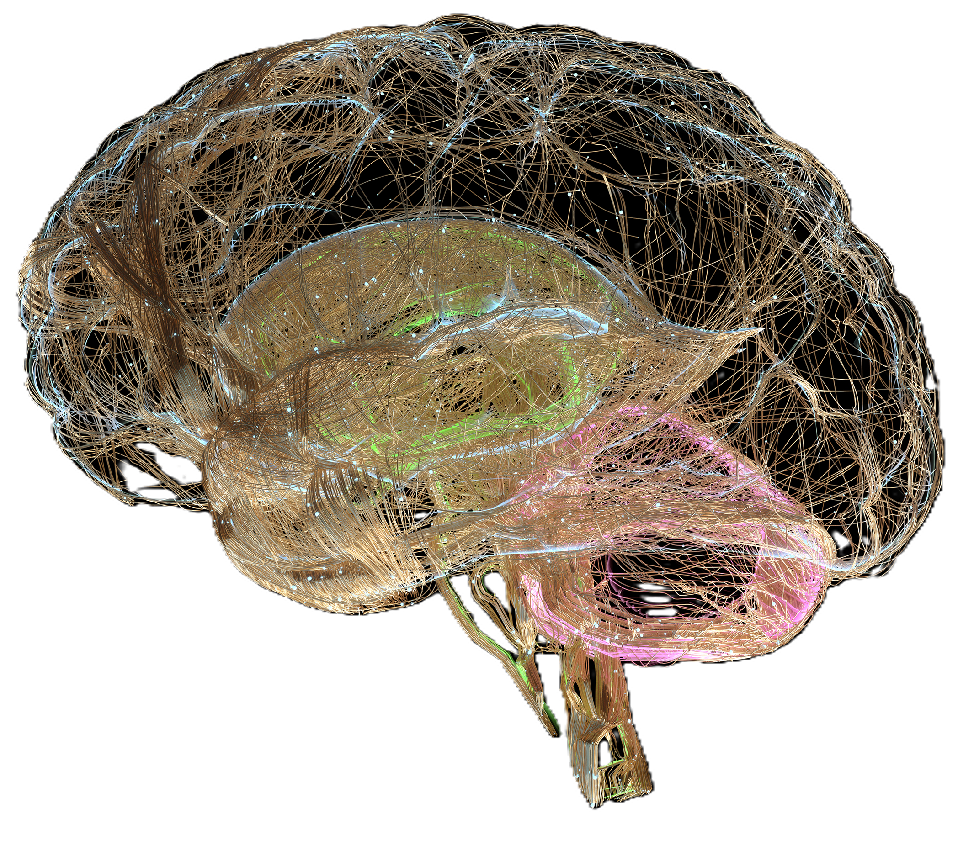
Identity Evolution Matrix™
From Reactive to Evolutionary — The Neuroscience of Who You Are
Identity Level
Brain Dominance
Core Question
Outcome
Reactive (Survivor)
Amygdala + Survival Brain
How do I survive?
Repeated Past
Intentional (Creator)
Mid-Brain + Prefrontal Cortex
Who must I become?
Desired Future
Evolutionary (Legacy Architect)
Integrated Prefrontal Cortex
What legacy must I create?
Generational Impact
Which level are you operating from? Your brain is not your destiny. Your identity is.
© 2026 Tony J. Selimi. All Rights Reserved.

Slide 10

The Identity Evolution Formula™
Change your identity, and you change everything that follows.
"A fearful identity sees threats everywhere. A legacy identity sees possibilities others cannot yet see."
This is not motivation. It is neuroscience applied to leadership — the precise mechanism by which your deepest beliefs become your lived reality, your revenue, and your relationships.
Identity
Perception
Emotion
Behaviour
Results
Identity is not what you say. It is what your nervous system believes to be true about you.
The Reticular Activating System (RAS) acts as the neurological gatekeeper between identity and perception — filtering reality based on who you believe yourself to be.
© 2026 Tony J. Selimi. All Rights Reserved.

Slide 11

The ALARM® Framework
From Reaction to Conscious Leadership
A — Acknowledge
L — Locate
A — Awaken
Face the truth. No blame, no denial.
Find the repeating pattern.
Identify the belief driving it.
R — Reframe
M — Mobilise
Extract the lesson, not the shame.
Take aligned action. Become who you must be.
© 2026 Tony J. Selimi. All Rights Reserved.

Slide 12
The 12-Step Growth Accelerator Method®— One Transformation
Define Personal Philosophy
Know the End in Mind
Learn the Art of Pitching
Establish Values Aligned Partnerships
Know the Pain. Teach the Solution.
Publish Your Ideas
Build a Prosperity Mindset
Master the Art of Selling
Create Product Eco-System
Grow Your Profile
Invest in Publicity
Thrive with Philanthropy
© 2026 Tony J. Selimi. All Rights Reserved.

Slide 13

What High-Value Leadership Actually Looks Like
Strength with Empathy
Ambition with Purpose
Discipline with Emotional Intelligence
Power with responsibility. Confidence with humility.
Values-driven life, clear vision. Success measured by significance.
Master yourself before leading others.
"A man who leads from ego creates fear. A man who leads from wisdom creates trust."
© 2026 Tony J. Selimi. All Rights Reserved.

Slide 14




Transformation in Action: Real Results
Patterns repeated across industries, roles, and cultures — the architecture of change is universal.
Entrepreneur
CEO
Couple
Author & Thought Leader
Plateaued revenue, decision fatigue, burnout → Rebuilt business ecosystem, restored clarity, scaled without constant personal presence.
External success, internal misalignment, relational drift → Recalibrated identity, restored leadership effectiveness, rebuilt family connection.
Communication breakdown, intimacy loss, conflict → Renewed connection, values alignment, and a sustainable partnership by design.
Invisible expertise, no platform → Published authority, profitable brand, global influence and recognition.
© 2026 Tony J. Selimi. All Rights Reserved.

Slide 15
The Transformation Path: Choose Your Entry Point
Every entry point leads to the same destination — the next version of you.
Private & VIP Advisory
Immersive 5-Day Training
Group & Specialist Programmes
The fastest path. Tailored, strategic, by invitation.
Udemy Courses
Years of insight compressed into five transformational days.
Books
Foundational frameworks. Self-directed transformation.
Structured learning. Immediately applicable.
Human Potential, Author Growth, Relationship Renaissance.
© 2026 Tony J. Selimi. All Rights Reserved.

Slide 16
Levels of Engagement: Tailored to Your Investment
Level
What It Includes
How to Access
Entry — Books & Courses
Foundational frameworks for self-directed transformation. Award-winning bestsellers and structured online learning.
Books on Amazon | Udemy Courses
Growth — Advisory, strategic consultations and Specialist Programmes
Business and Human Potential, Author & Influence Growth, Relationship Renaissance,Business, Life — structured, results-oriented transformation.
info@tonyselimi.com
Immersive — 5-Day Training
Bespoke, intensive, one-to-one. Compress years of insight into five transformational days.
Explore here or contact info@tonyselimi.com
Private Advisory
For 7, 8 & 9-figure leaders. Deeply personal, strategic, and tailored to your exact situation.
info@tonyselimi.com via PA
© 2026 Tony J. Selimi. All Rights Reserved.

Slide 17

VIP Private Advisory — By Invitation Only
For Those Whose Decisions Shape Legacies
Rigorously Limited
To Explore Fit
Five clients per year. Booked 3–6 months in advance. By invitation only. There is no application form.
Contact: info@tonyselimi.com
UHNWIs, family offices, founders and global leaders at £10M+ — whose choices influence companies, families, communities, and generational wealth.
The higher you climb, the more precise you must become. This is the private room where that precision is built.
© 2026 Tony J. Selimi. All Rights Reserved.

Slide 18
Imagine Yourself 12 Months From Today
OPTION A — SAME PATH
OPTION B — RECALIBRATED
The Cost of Continuity
The Return on Transformation
Same patterns. Same plateaus. Same challenges compounding quietly across your health, your relationships, your business, and the legacy you intend to leave.
Time is the one asset that cannot be recovered. Every month of delay is a month of compound cost.
Clarity of purpose. Aligned strategy. Stronger relationships. Sustainable performance. A legacy being built with intention rather than inherited by default.
Nobody wants a programme. They want the person they become after completing it — freedom, clarity, growth, influence, purpose, money, credibility, and legacy.
© 2026 Tony J. Selimi. All Rights Reserved.

Slide 19

The META:L Community Invitation
A respectful, time-sensitive courtesy — for those who are ready. Deadline: 31 July. Contact Tony's PA: info@tonyselimi.com
10% Saving
Non-UK Clients
Book any programme or service. A gracious acknowledgement for those who choose to act.
No additional 20% VAT payable — a significant further advantage for international clients.
"This is not a discount. It is a courtesy extended to those who recognise the moment."
© 2026 Tony J. Selimi. All Rights Reserved.

Slide 20


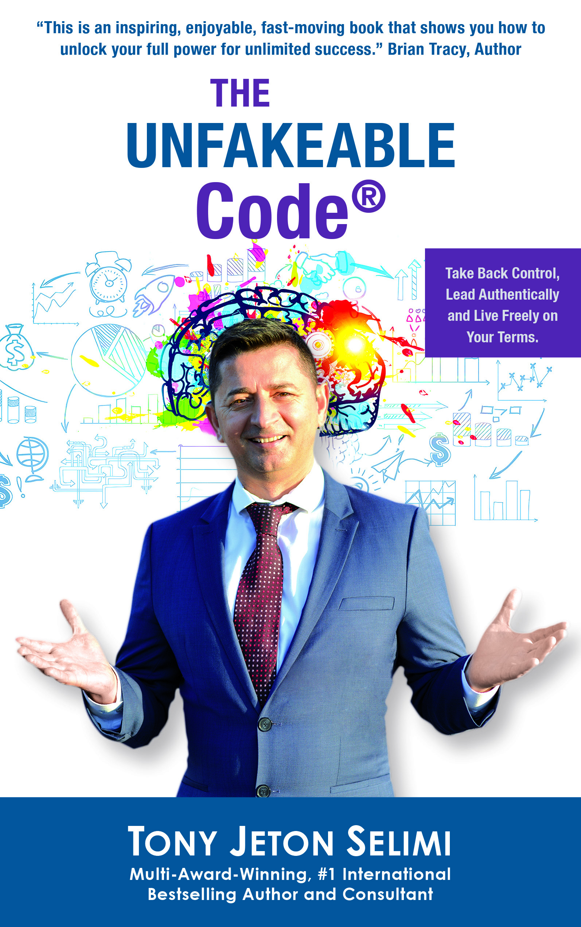
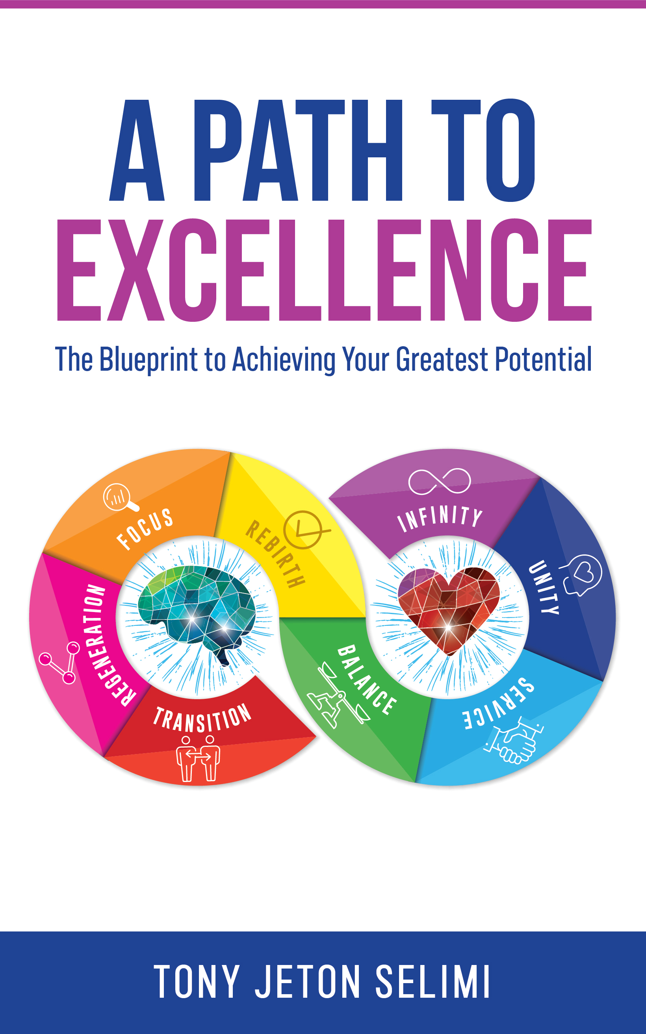
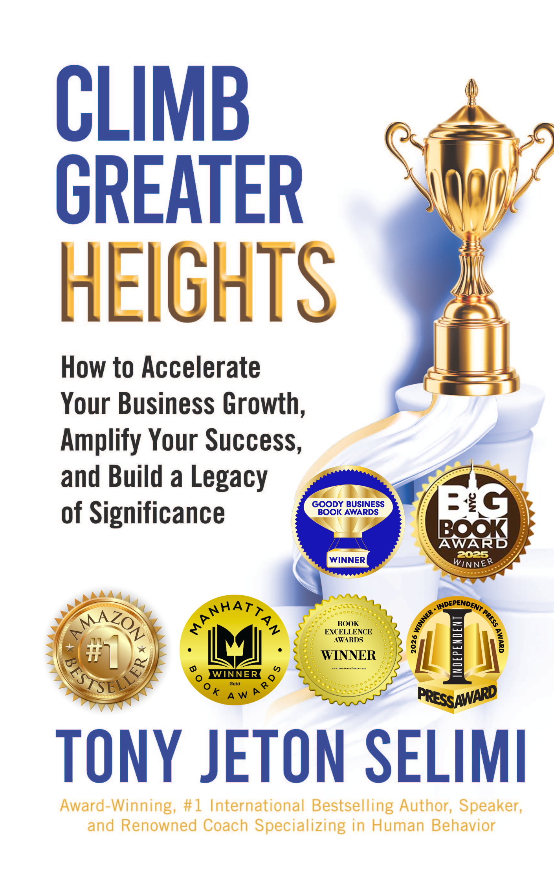
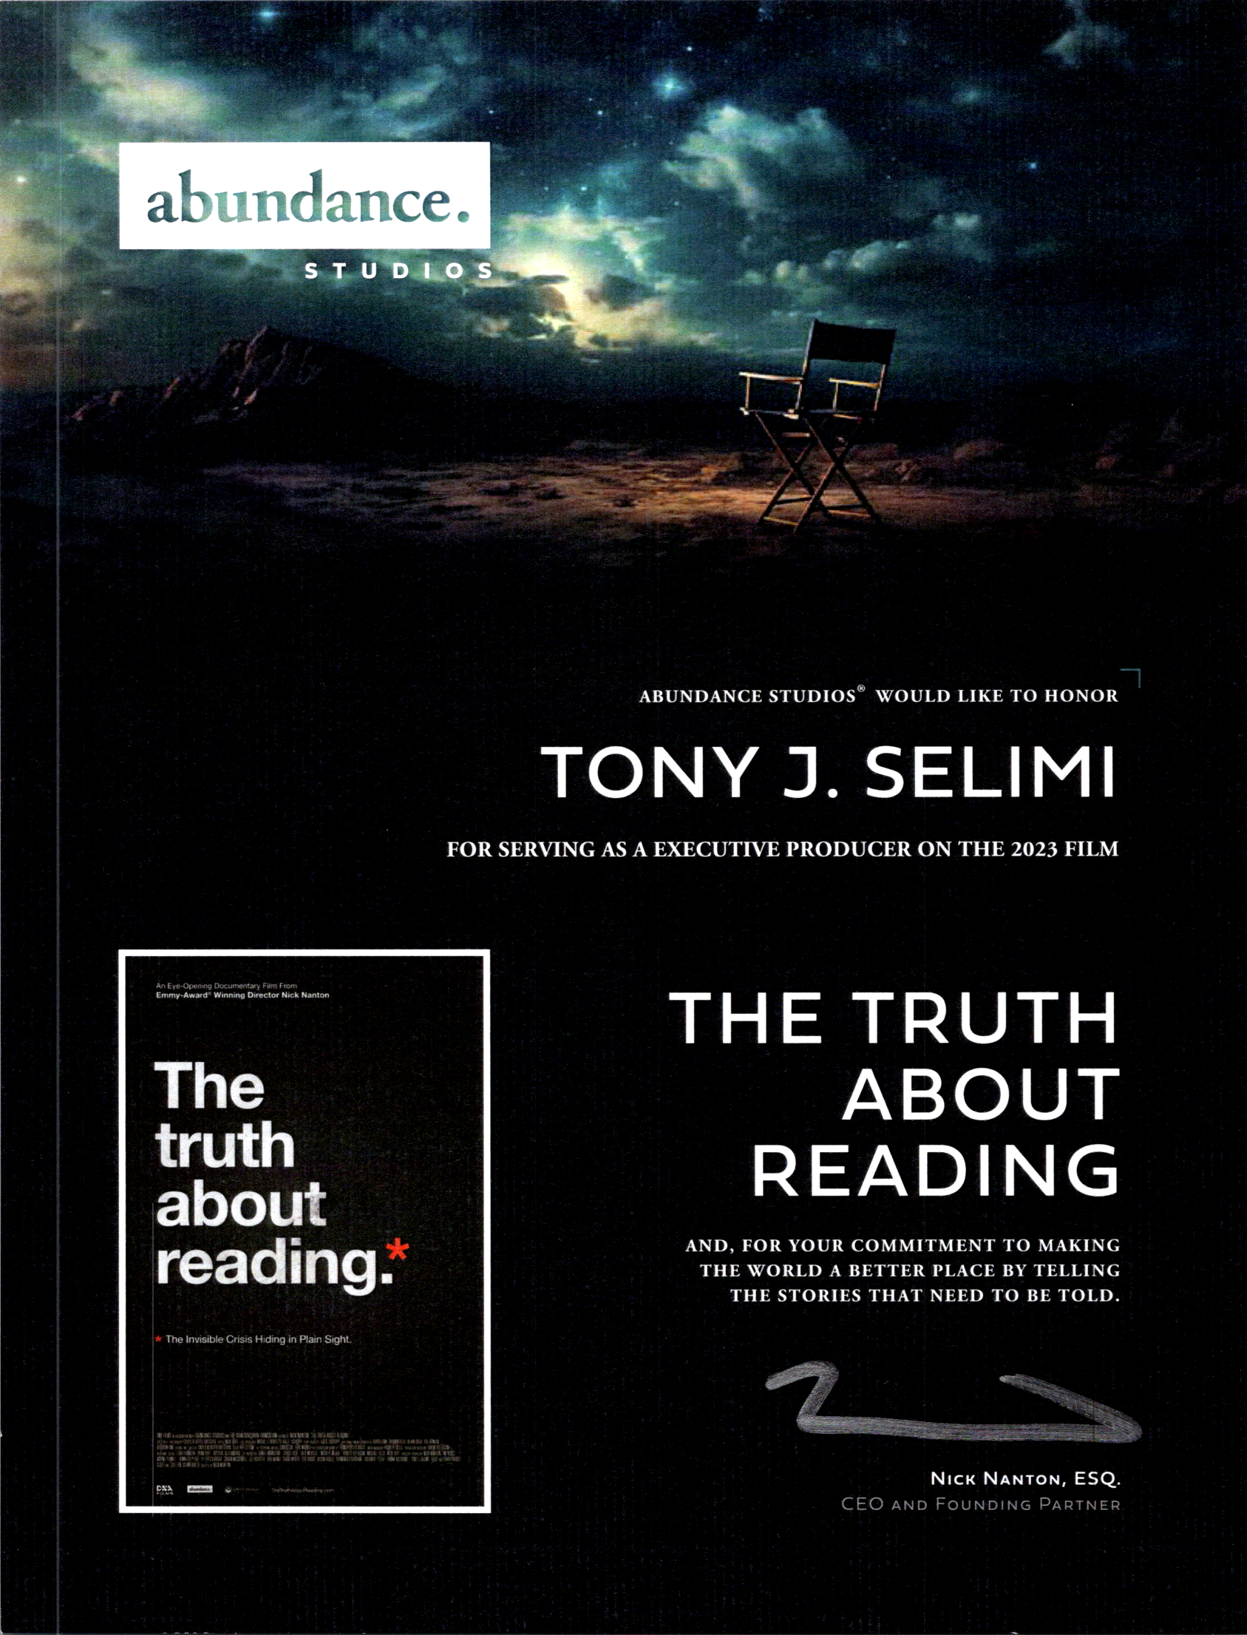

Books, Courses & Self-Mastery Resources
Books — Begin the Foundation
Udemy Courses — Structured & Accessible
Shop, Programmes & Consultations
Several award-winning bestsellers, including Climb Greater Heights — the frameworks, the philosophy, and the self-directed path to transformation.
amazon.com — Tony J. Selimi | tonyselimi.com/books
Learn at your own pace with courses including Fundamentals of Mindfulness for Business — immediately applicable, professionally structured.
Tony J. Selimi on Udemy
Explore all investment levels — from specialist programmes to private advisory and immersive training experiences.
tonyselimi.com/shop
© 2026 Tony J. Selimi. All Rights Reserved.

Slide 21


Slide 22

The Next Step: One Conversation Changes Everything
If this presentation has reflected a challenge or possibility you recognise — the next step is a focused conversation. Book a Discovery Consultation Now!
Contact Tony's PA — info@tonyselimi.com
Website & Shop — tonyselimi.com/shop
Books — Amazon
LinkedIn & Linktree — linkedin.com/in/tonyjselimi | linktr.ee/TonyJSelimi
© 2026 Tony J. Selimi. All Rights Reserved.

